Slide 1

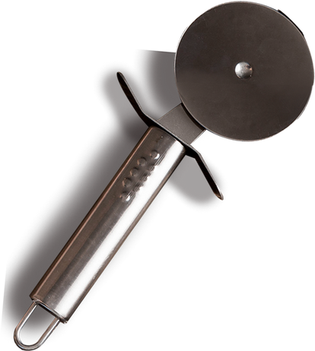
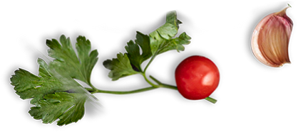
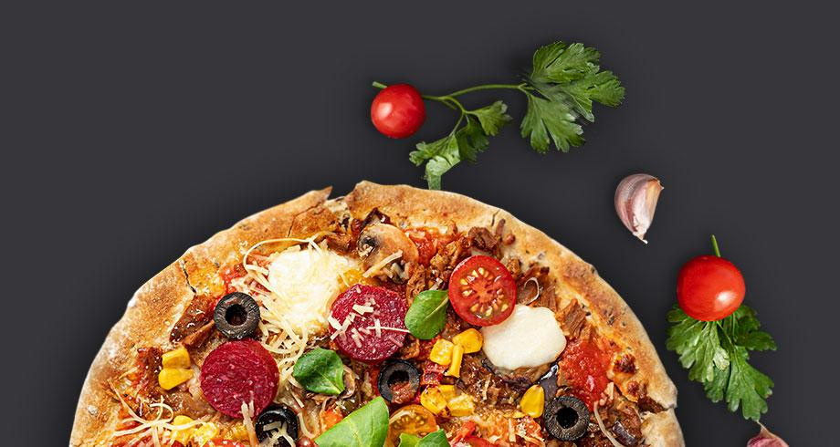
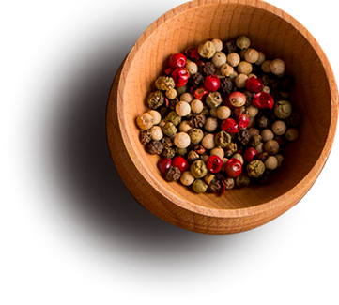

PIZZA OUTLET SALES ...
Lets get explore the world of pizza in year 2015
PROJECT OWNER: ADITI VIRMANI

Slide 2
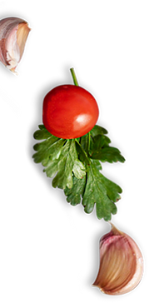


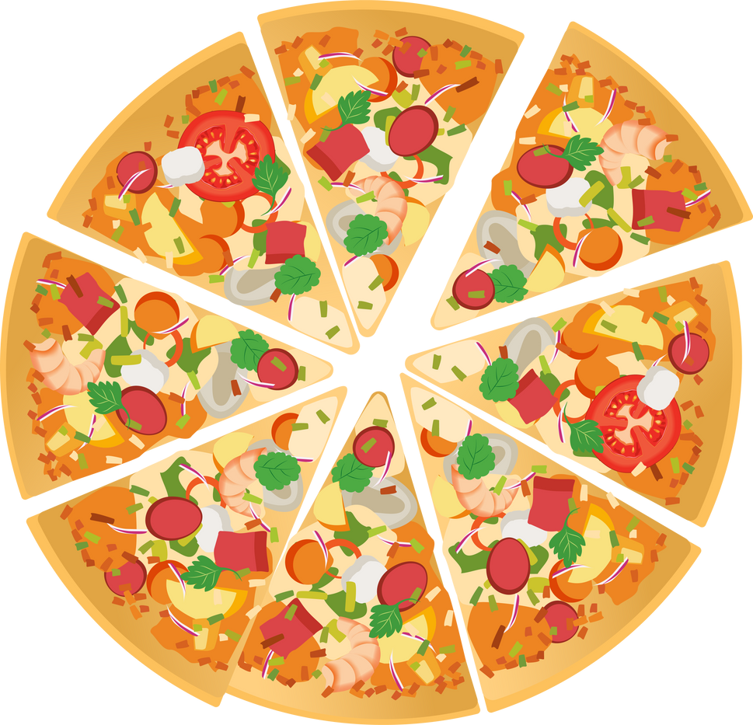
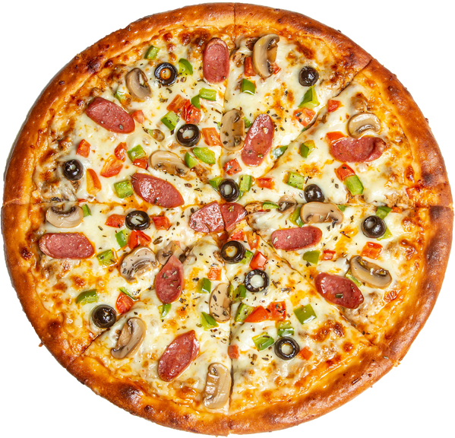


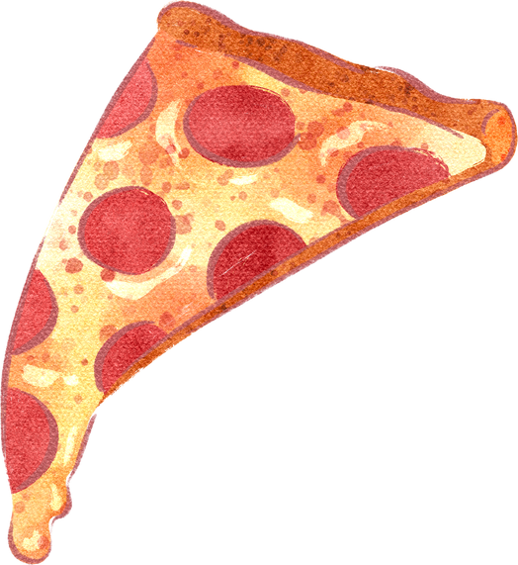
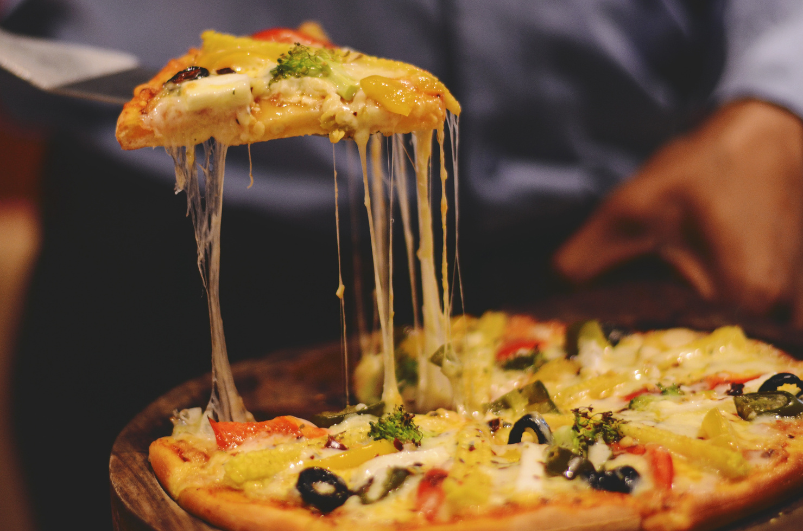

CONTENT
11I 1. INTRODUCTION
2. SCOPE OF THE PROJECT
4. GOALS AND KPIs
5. BASIC PROCEDURE AND UNDERSTANDINGS
7.RECOMMENDED ANALYSIS
8.CONCLUSION
2

Slide 3

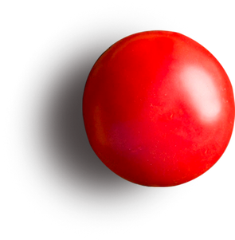





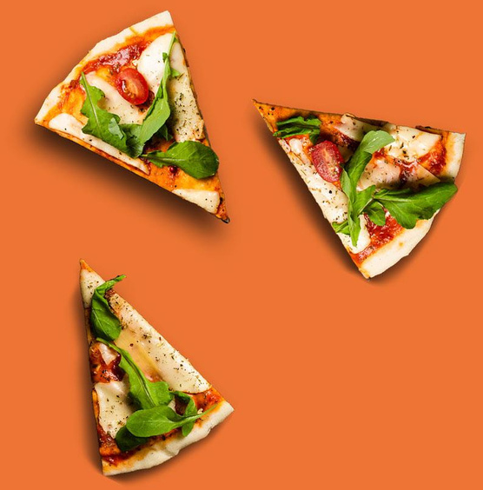



INTRODUCTION
: We have data of complete year 2015 worth of sales from a fictitious pizza place, including the date and time of each order and the pizzas, served, with additional details on the type, size, quantity, price, and ingredients.
, we need to analyse the outlet’s whole year’s data so that we will improve and take valuable action on the above questions. Let us check whether is it a big project or small project? Let us understand whole data and feedback of the pizza outlet for the year 2015
.

Slide 4


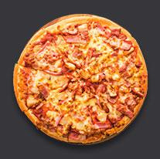

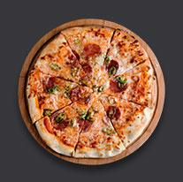
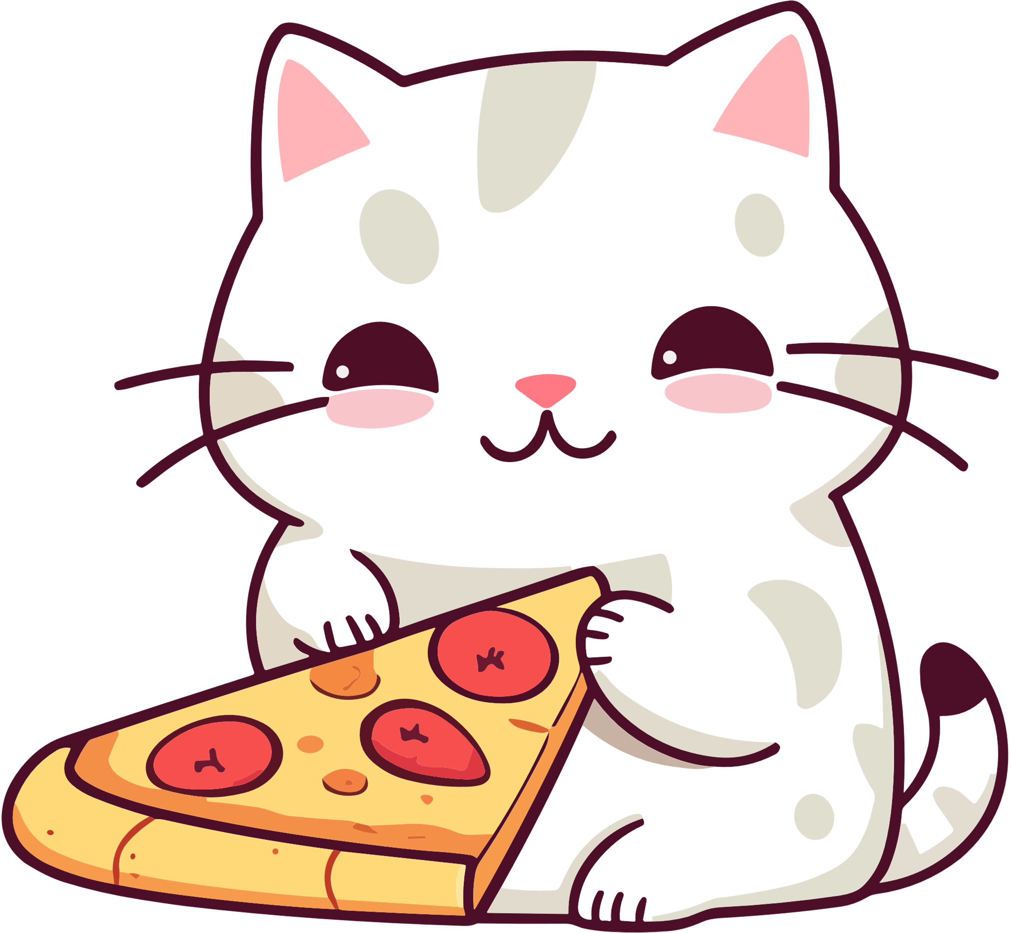


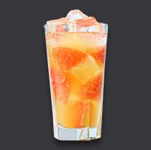
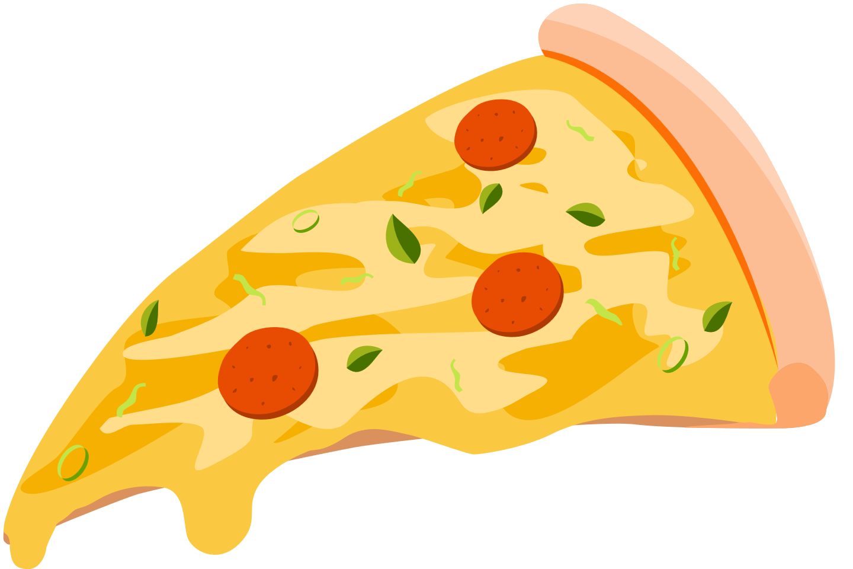
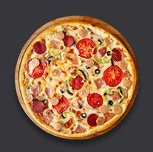

SCOPE OF THE PROJECT
Understand the Pizza Outlet Data of the year 2015 and get the valuable insights, KPIs, root causes to improve the business from the next year onwards.

Slide 5




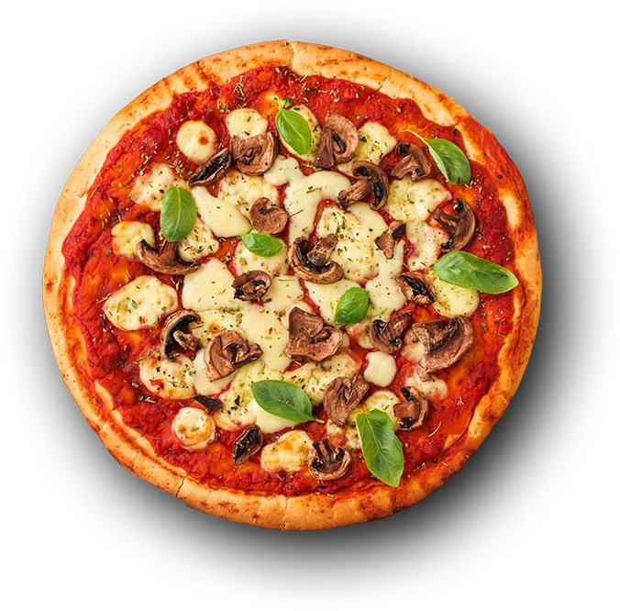



GOALS AND KPIs
Improve the Sale count of the pizza
2. Happy Customers
3. promotions and offers for large amount of customer attraction

Slide 6

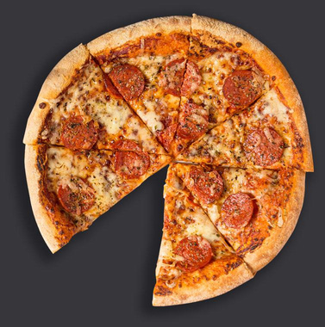

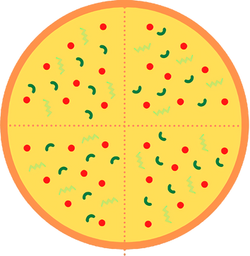



BASIC PROCEDURE AND UNDERSTANDINGS
· Market Understanding
· Customer Demographic
· Customer Behavior
· Customer Retention
· New Customer Acquisition

Slide 7

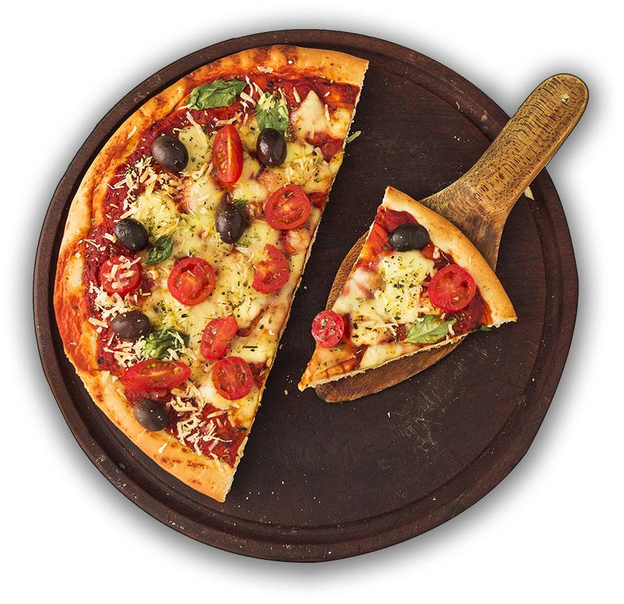
MARKET UNDERSTANDING
In this project we realised that market is working on the seasonally and occasionally pizza sale count we analysed in the project that summer season has the highest sales and on daily basis at the time of snaking we had great sale count. In the summer season customer used to order veggies loaded pizza and in rains they used to order classic pizza and supreme pizza, and in winters & Spring supreme category and chicken pizza was mostly loved by the customers.

Slide 8




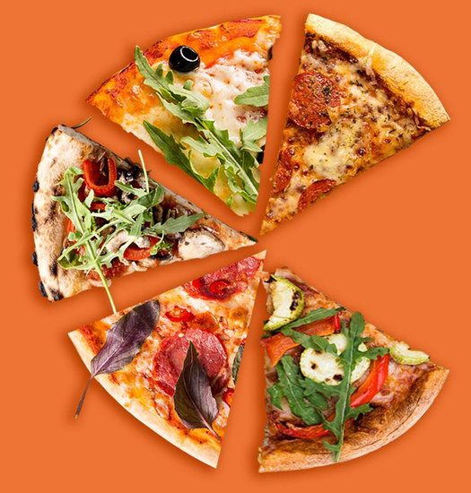

Customer Demographic
Based on customer demographic understand we realised that season wise customer used to chose the type of the pizza based on the ingredients that what ingredients he wants in his pizza. In the summer season customer used to order veggies loaded pizza and in rains they used to order classic pizza and supreme pizza, and in winters & Spring supreme category and chicken pizza was mostly loved by the customers.

Slide 9



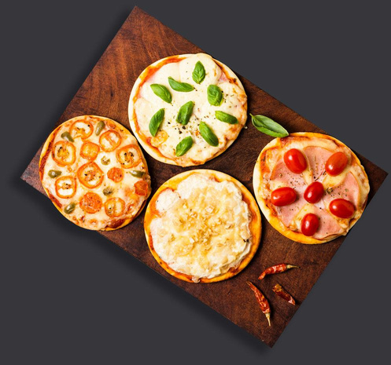

Customer Behaviour
No. of customer count and there ordered pizza count with quantities will also let us know how we can improve our business. In this project we found that we have lot of common customers for the pizza sales.

Slide 10

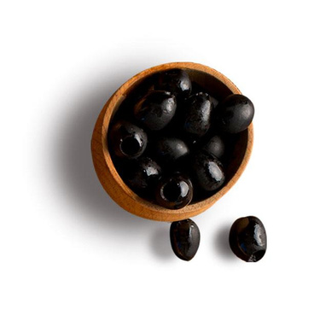

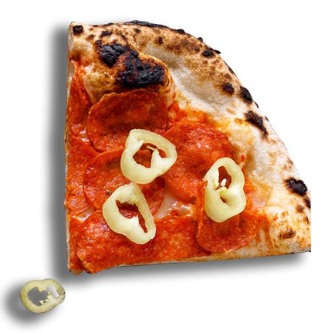

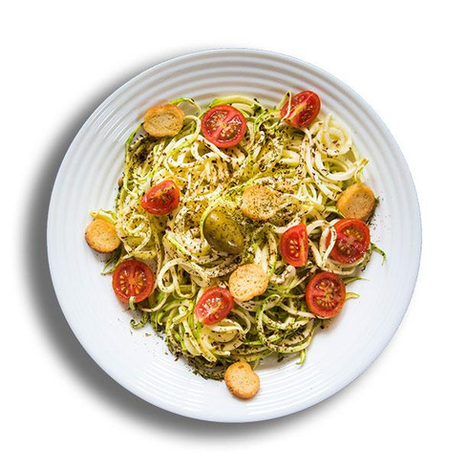
New Customer Acquisition
For new and more customer acquisition we need to get the feedbacks from the customers we need to understand their taste and as we saw based on occasion and season, we have highest the sale count we will increase the varieties at that time and the least sold pizzas we will improve their quality and prices.

Slide 11
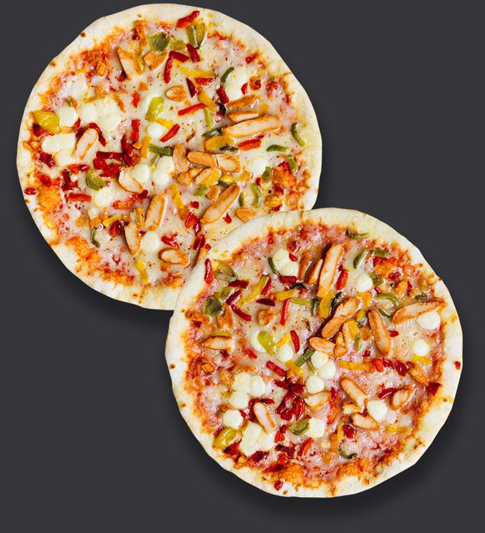

RECOMMENDED ANALYSIS
$10
1. How many customers do we have each day? Are there any peak hours? | 1. How many customers do we have each day? Are there any peak hours? | 1. How many customers do we have each day? Are there any peak hours? | 1. How many customers do we have each day? Are there any peak hours? | 1. How many customers do we have each day? Are there any peak hours? | 1. How many customers do we have each day? Are there any peak hours? | 1. How many customers do we have each day? Are there any peak hours?
2. How many pizzas are typically in order? Do we have any bestsellers? | 2. How many pizzas are typically in order? Do we have any bestsellers? | 2. How many pizzas are typically in order? Do we have any bestsellers? | 2. How many pizzas are typically in order? Do we have any bestsellers? | 2. How many pizzas are typically in order? Do we have any bestsellers? | 2. How many pizzas are typically in order? Do we have any bestsellers? | 2. How many pizzas are typically in order? Do we have any bestsellers?
3. How much money did we make this year? Can we identify any seasonality in the sales? | 3. How much money did we make this year? Can we identify any seasonality in the sales? | 3. How much money did we make this year? Can we identify any seasonality in the sales? | 3. How much money did we make this year? Can we identify any seasonality in the sales? | 3. How much money did we make this year? Can we identify any seasonality in the sales? | 3. How much money did we make this year? Can we identify any seasonality in the sales? | 3. How much money did we make this year? Can we identify any seasonality in the sales? | 3. How much money did we make this year? Can we identify any seasonality in the sales?
4. Are there any pizzas we should take off the menu, or any promotions we could leverage? | 4. Are there any pizzas we should take off the menu, or any promotions we could leverage? | 4. Are there any pizzas we should take off the menu, or any promotions we could leverage? | 4. Are there any pizzas we should take off the menu, or any promotions we could leverage? | 4. Are there any pizzas we should take off the menu, or any promotions we could leverage? | 4. Are there any pizzas we should take off the menu, or any promotions we could leverage? | 4. Are there any pizzas we should take off the menu, or any promotions we could leverage? | 4. Are there any pizzas we should take off the menu, or any promotions we could leverage?

Slide 12

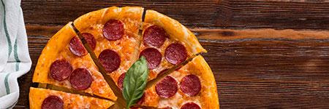
. How many customers do we have each day? Are there any peak hours? | . How many customers do we have each day? Are there any peak hours? | . How many customers do we have each day? Are there any peak hours? | . How many customers do we have each day? Are there any peak hours? | . How many customers do we have each day? Are there any peak hours? | . How many customers do we have each day? Are there any peak hours? | . How many customers do we have each day? Are there any peak hours? | . How many customers do we have each day? Are there any peak hours? | . How many customers do we have each day? Are there any peak hours? | . How many customers do we have each day? Are there any peak hours? | . How many customers do we have each day? Are there any peak hours? | . How many customers do we have each day? Are there any peak hours?
Average count of customers in each day is: 60 | Average count of customers in each day is: 60 | Average count of customers in each day is: 60 | Average count of customers in each day is: 60 | Average count of customers in each day is: 60 | Average count of customers in each day is: 60 | *There are two peak hours which are from- 12pm to 1pm(2455-2520 sale count) and 5pm to 6pm(2336-2399 sale count). | *There are two peak hours which are from- 12pm to 1pm(2455-2520 sale count) and 5pm to 6pm(2336-2399 sale count). | *There are two peak hours which are from- 12pm to 1pm(2455-2520 sale count) and 5pm to 6pm(2336-2399 sale count). | *There are two peak hours which are from- 12pm to 1pm(2455-2520 sale count) and 5pm to 6pm(2336-2399 sale count). | *There are two peak hours which are from- 12pm to 1pm(2455-2520 sale count) and 5pm to 6pm(2336-2399 sale count). | *There are two peak hours which are from- 12pm to 1pm(2455-2520 sale count) and 5pm to 6pm(2336-2399 sale count).
Max count of customers were on : 27th NOV 2015 | Max count of customers were on : 27th NOV 2015 | Max count of customers were on : 27th NOV 2015 | Max count of customers were on : 27th NOV 2015 | Max count of customers were on : 27th NOV 2015 | Max count of customers were on : 27th NOV 2015 | *There are two peak hours which are from- 12pm to 1pm(2455-2520 sale count) and 5pm to 6pm(2336-2399 sale count). | *There are two peak hours which are from- 12pm to 1pm(2455-2520 sale count) and 5pm to 6pm(2336-2399 sale count). | *There are two peak hours which are from- 12pm to 1pm(2455-2520 sale count) and 5pm to 6pm(2336-2399 sale count). | *There are two peak hours which are from- 12pm to 1pm(2455-2520 sale count) and 5pm to 6pm(2336-2399 sale count). | *There are two peak hours which are from- 12pm to 1pm(2455-2520 sale count) and 5pm to 6pm(2336-2399 sale count). | *There are two peak hours which are from- 12pm to 1pm(2455-2520 sale count) and 5pm to 6pm(2336-2399 sale count).
Min Count of customers were on : 29th DEC 2015 | Min Count of customers were on : 29th DEC 2015 | Min Count of customers were on : 29th DEC 2015 | Min Count of customers were on : 29th DEC 2015 | Min Count of customers were on : 29th DEC 2015 | Min Count of customers were on : 29th DEC 2015 | *There are two peak hours which are from- 12pm to 1pm(2455-2520 sale count) and 5pm to 6pm(2336-2399 sale count). | *There are two peak hours which are from- 12pm to 1pm(2455-2520 sale count) and 5pm to 6pm(2336-2399 sale count). | *There are two peak hours which are from- 12pm to 1pm(2455-2520 sale count) and 5pm to 6pm(2336-2399 sale count). | *There are two peak hours which are from- 12pm to 1pm(2455-2520 sale count) and 5pm to 6pm(2336-2399 sale count). | *There are two peak hours which are from- 12pm to 1pm(2455-2520 sale count) and 5pm to 6pm(2336-2399 sale count). | *There are two peak hours which are from- 12pm to 1pm(2455-2520 sale count) and 5pm to 6pm(2336-2399 sale count).

Slide 13
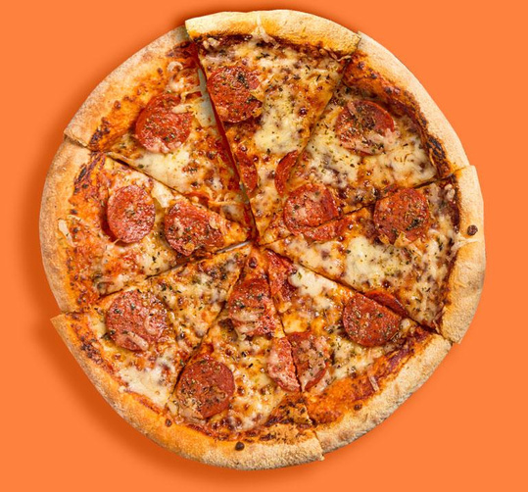
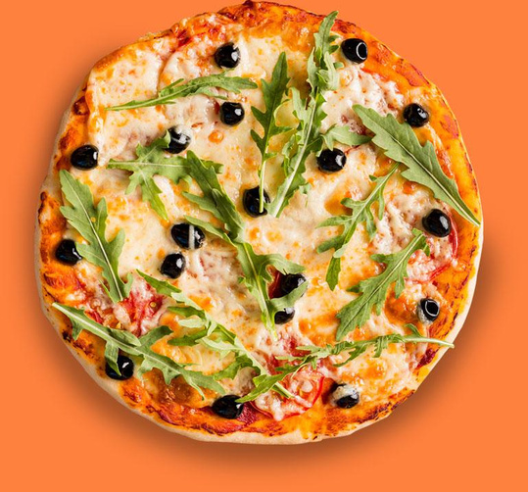
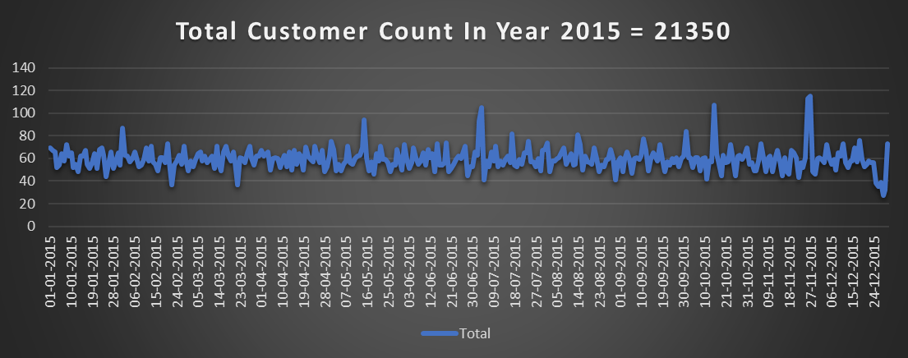

Mercury
Uranus

Slide 14
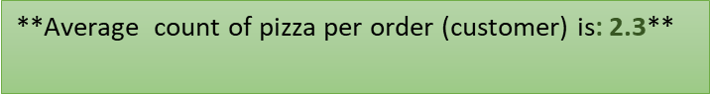
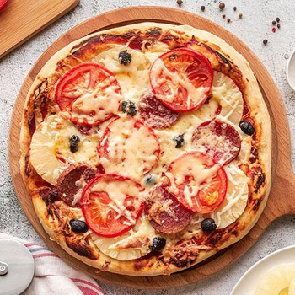
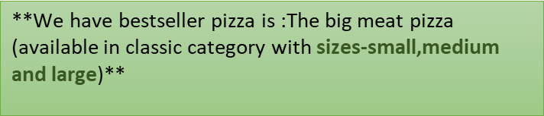
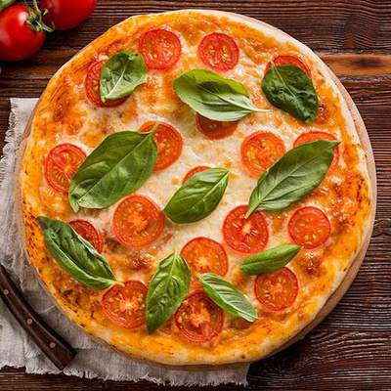
How many pizzas are typically in order? Do we have any bestsellers? | How many pizzas are typically in order? Do we have any bestsellers? | How many pizzas are typically in order? Do we have any bestsellers? | How many pizzas are typically in order? Do we have any bestsellers? | How many pizzas are typically in order? Do we have any bestsellers? | How many pizzas are typically in order? Do we have any bestsellers? | How many pizzas are typically in order? Do we have any bestsellers? | How many pizzas are typically in order? Do we have any bestsellers? | How many pizzas are typically in order? Do we have any bestsellers? | How many pizzas are typically in order? Do we have any bestsellers? | How many pizzas are typically in order? Do we have any bestsellers? | How many pizzas are typically in order? Do we have any bestsellers? | How many pizzas are typically in order? Do we have any bestsellers? | How many pizzas are typically in order? Do we have any bestsellers? | How many pizzas are typically in order? Do we have any bestsellers? | How many pizzas are typically in order? Do we have any bestsellers? | How many pizzas are typically in order? Do we have any bestsellers? | How many pizzas are typically in order? Do we have any bestsellers? | How many pizzas are typically in order? Do we have any bestsellers? | How many pizzas are typically in order? Do we have any bestsellers? | How many pizzas are typically in order? Do we have any bestsellers? | How many pizzas are typically in order? Do we have any bestsellers? | How many pizzas are typically in order? Do we have any bestsellers? | How many pizzas are typically in order? Do we have any bestsellers? | How many pizzas are typically in order? Do we have any bestsellers?

Slide 15
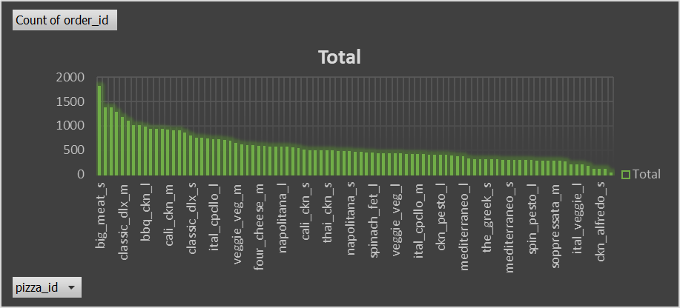

Slide 16

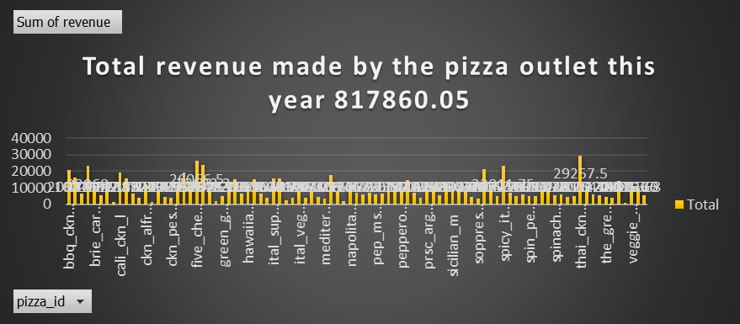
How much money did we make this year? Can we identify any seasonality in the sales? | How much money did we make this year? Can we identify any seasonality in the sales? | How much money did we make this year? Can we identify any seasonality in the sales? | How much money did we make this year? Can we identify any seasonality in the sales? | How much money did we make this year? Can we identify any seasonality in the sales? | How much money did we make this year? Can we identify any seasonality in the sales? | How much money did we make this year? Can we identify any seasonality in the sales? | How much money did we make this year? Can we identify any seasonality in the sales? | How much money did we make this year? Can we identify any seasonality in the sales? | How much money did we make this year? Can we identify any seasonality in the sales? | How much money did we make this year? Can we identify any seasonality in the sales? | How much money did we make this year? Can we identify any seasonality in the sales? | How much money did we make this year? Can we identify any seasonality in the sales? | How much money did we make this year? Can we identify any seasonality in the sales? | How much money did we make this year? Can we identify any seasonality in the sales? | How much money did we make this year? Can we identify any seasonality in the sales? | How much money did we make this year? Can we identify any seasonality in the sales? | How much money did we make this year? Can we identify any seasonality in the sales? | How much money did we make this year? Can we identify any seasonality in the sales? | How much money did we make this year? Can we identify any seasonality in the sales? | How much money did we make this year? Can we identify any seasonality in the sales? | How much money did we make this year? Can we identify any seasonality in the sales? | How much money did we make this year? Can we identify any seasonality in the sales?

Slide 17

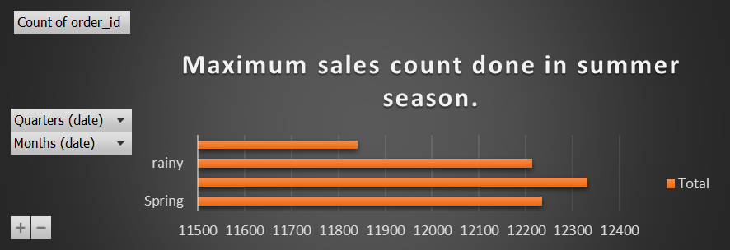
Mercury

Slide 18

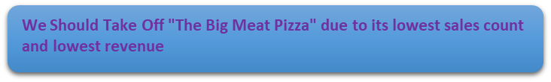
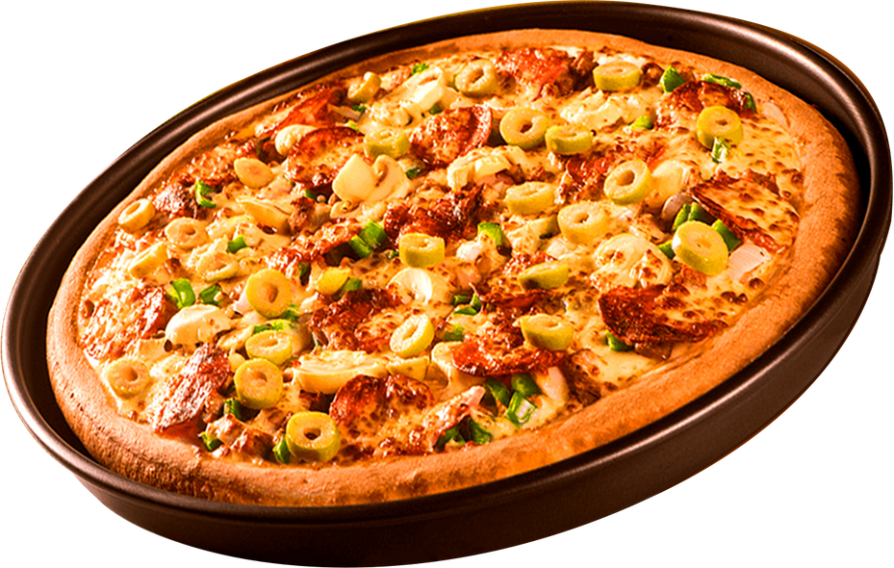
4. Are there any pizzas we should take off the menu, or any promotions we could leverage? | 4. Are there any pizzas we should take off the menu, or any promotions we could leverage? | 4. Are there any pizzas we should take off the menu, or any promotions we could leverage? | 4. Are there any pizzas we should take off the menu, or any promotions we could leverage? | 4. Are there any pizzas we should take off the menu, or any promotions we could leverage? | 4. Are there any pizzas we should take off the menu, or any promotions we could leverage? | 4. Are there any pizzas we should take off the menu, or any promotions we could leverage? | 4. Are there any pizzas we should take off the menu, or any promotions we could leverage? | 4. Are there any pizzas we should take off the menu, or any promotions we could leverage? | 4. Are there any pizzas we should take off the menu, or any promotions we could leverage? | 4. Are there any pizzas we should take off the menu, or any promotions we could leverage? | 4. Are there any pizzas we should take off the menu, or any promotions we could leverage? | 4. Are there any pizzas we should take off the menu, or any promotions we could leverage? | 4. Are there any pizzas we should take off the menu, or any promotions we could leverage? | 4. Are there any pizzas we should take off the menu, or any promotions we could leverage? | 4. Are there any pizzas we should take off the menu, or any promotions we could leverage? | 4. Are there any pizzas we should take off the menu, or any promotions we could leverage? | 4. Are there any pizzas we should take off the menu, or any promotions we could leverage? | 4. Are there any pizzas we should take off the menu, or any promotions we could leverage? | 4. Are there any pizzas we should take off the menu, or any promotions we could leverage? | 4. Are there any pizzas we should take off the menu, or any promotions we could leverage? | 4. Are there any pizzas we should take off the menu, or any promotions we could leverage?

Slide 19
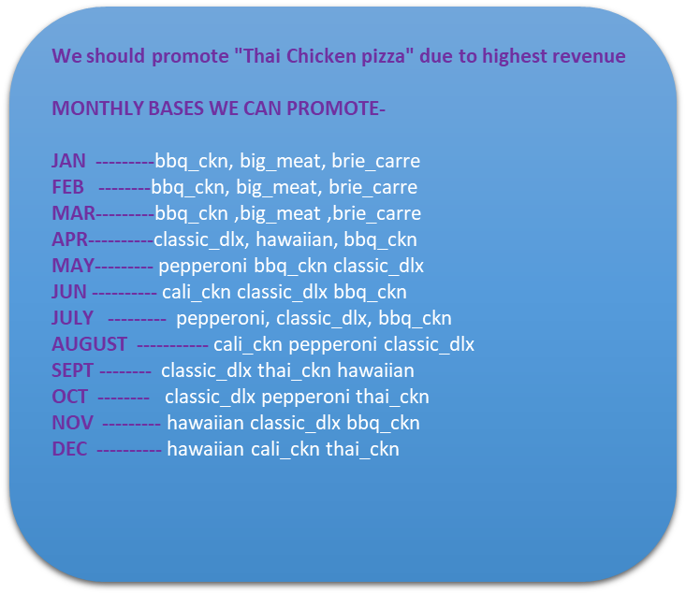


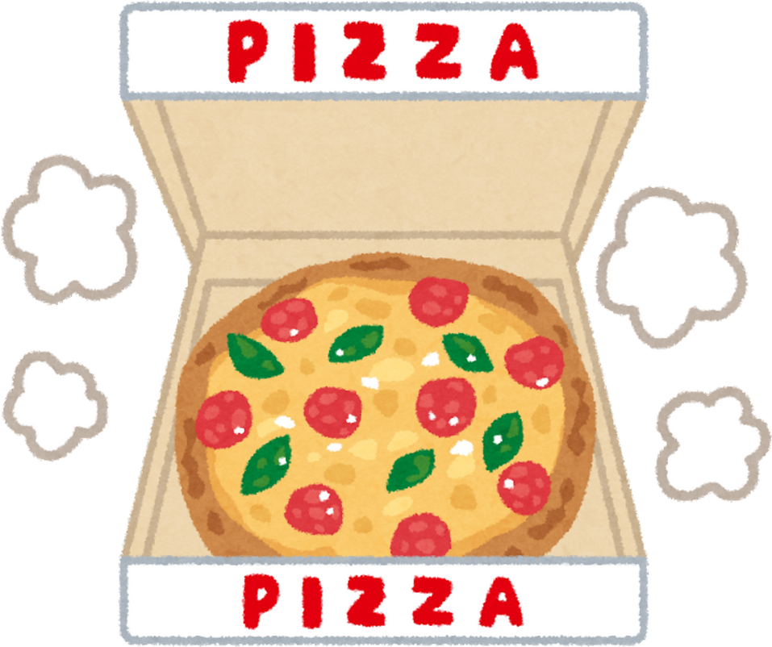
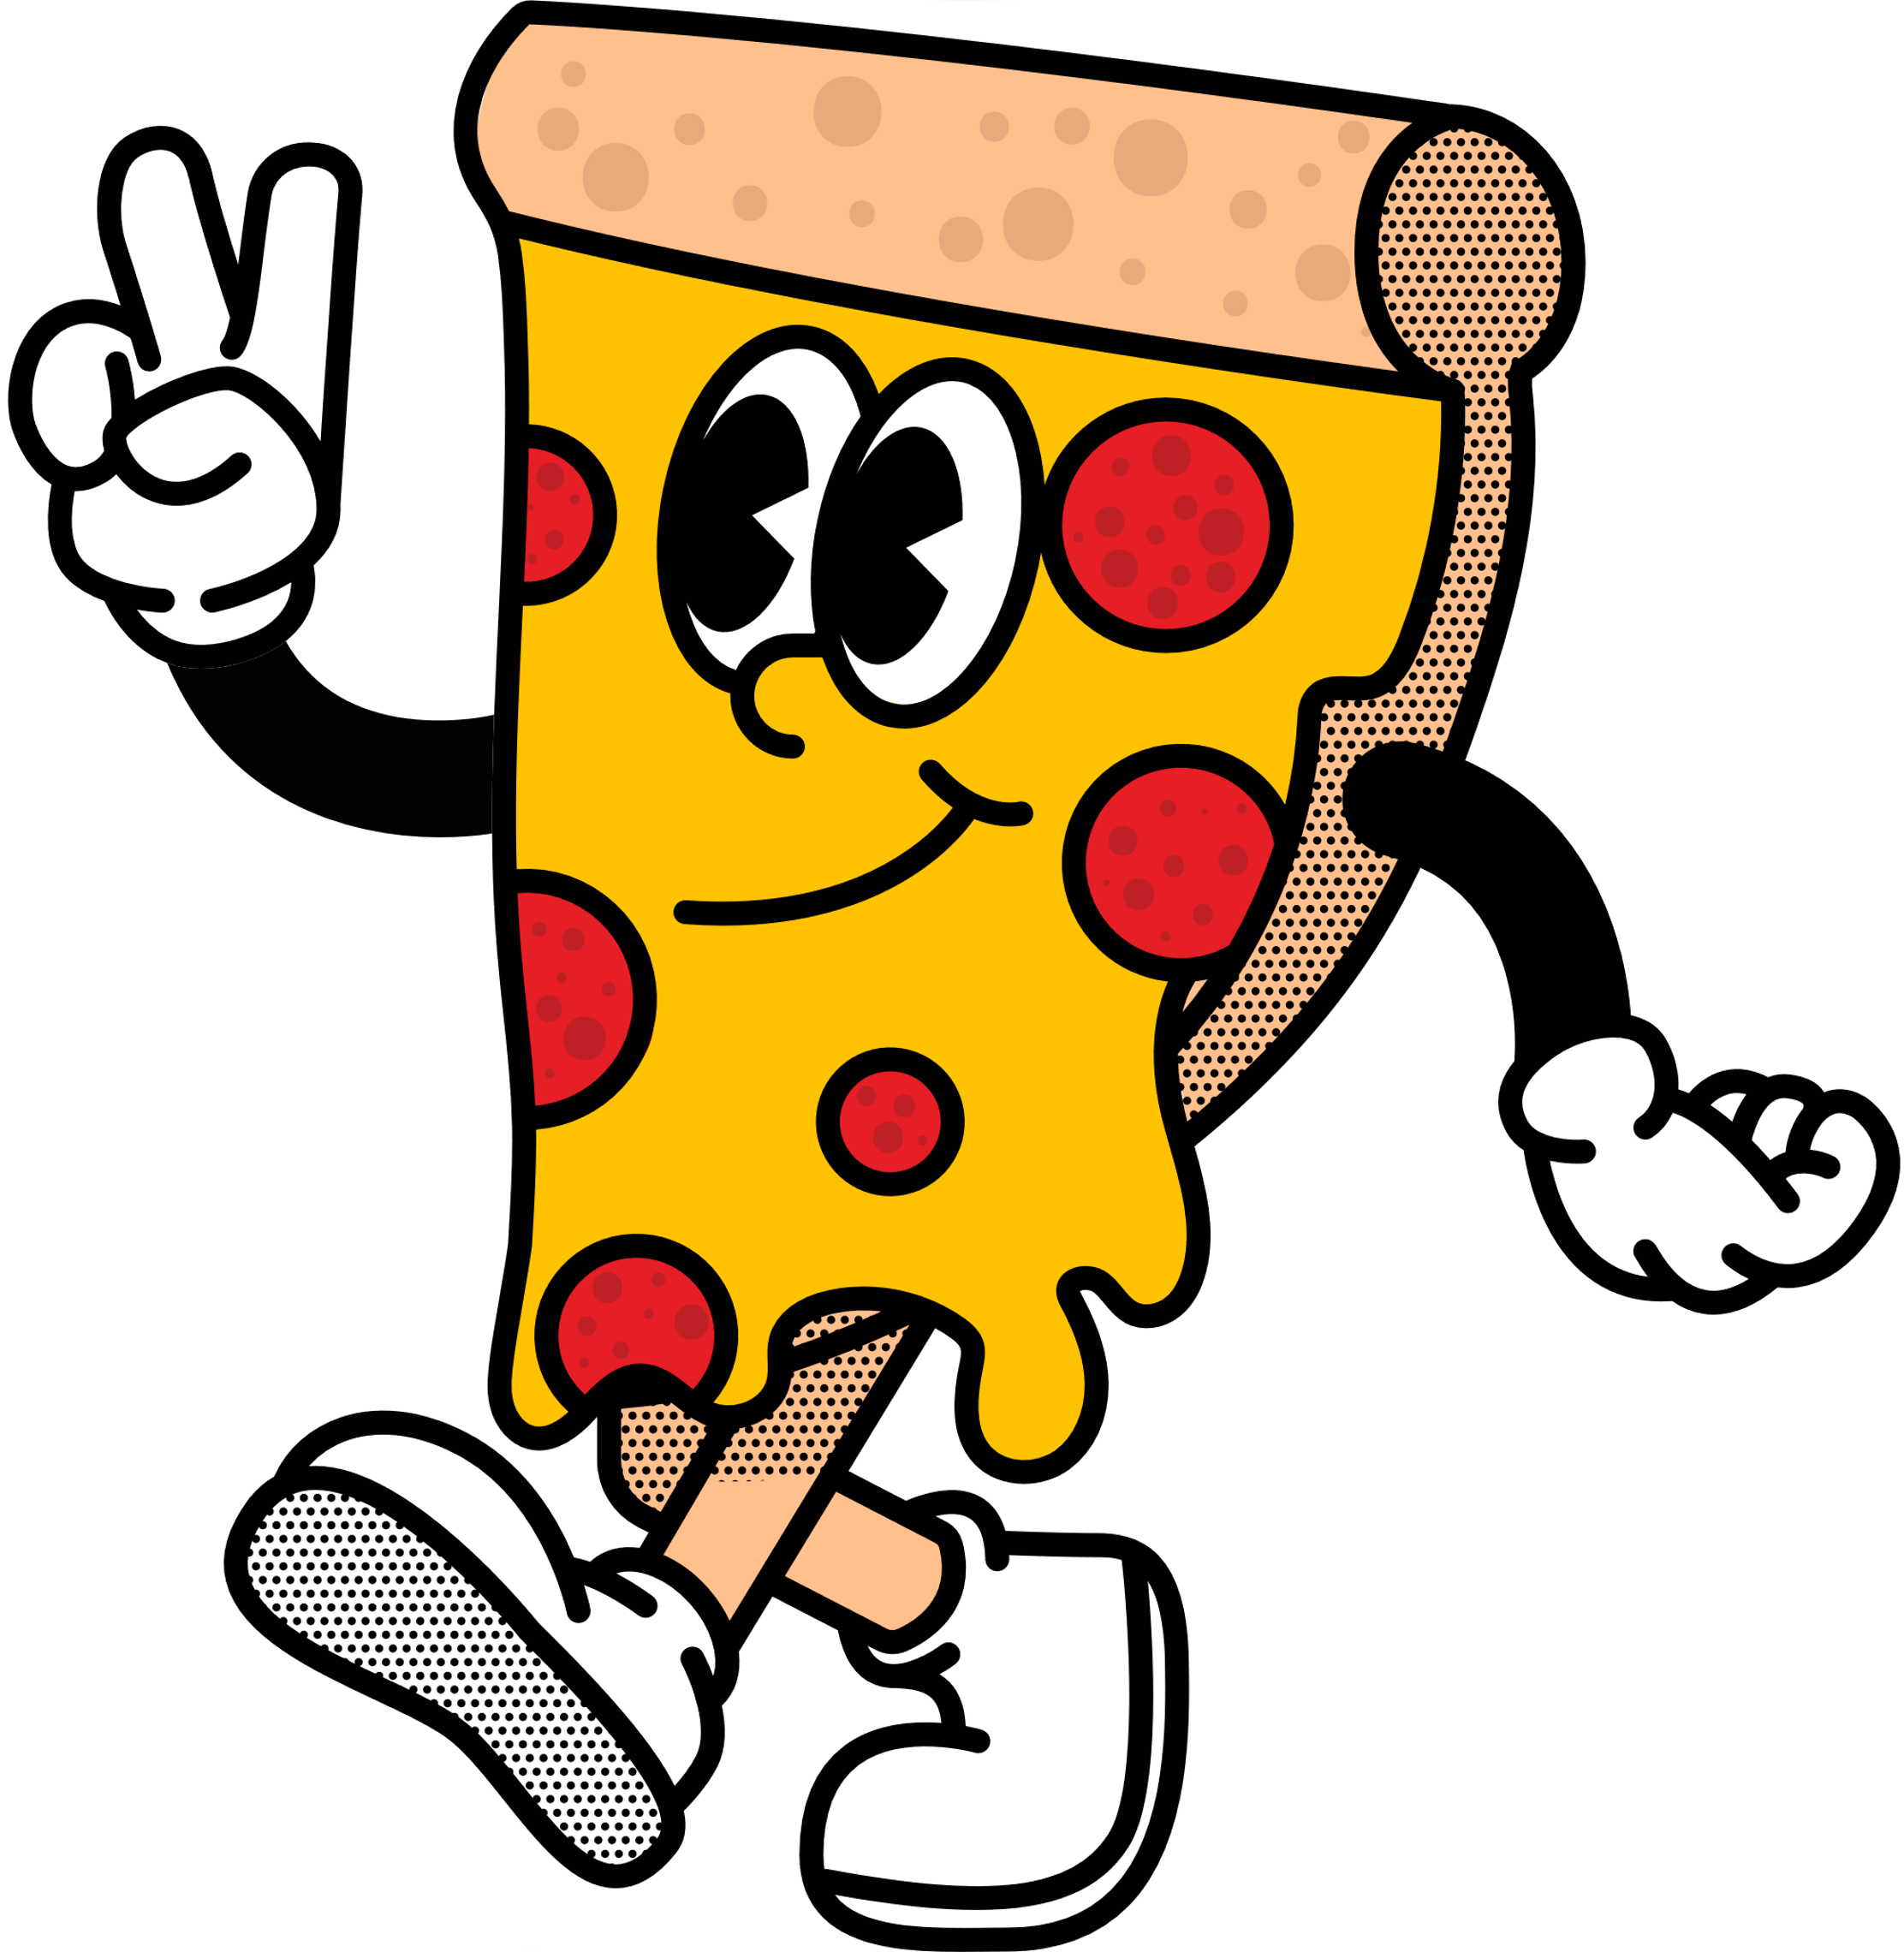

Slide 20

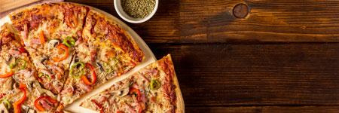



thANK yOU!!!
COMBO 1
COMBO 2
Mercury
$10.50
Neptune
$11.50
Jupiter
Saturn
$12.50
Mars
$12.00
Venus
$13.00
Earth
$10.50
Pluto
$14.50

